Slide 1
W203 STATS

Slide 2
Table of Contents
Week1: Intro
Week2: Exploratory Data Analysis
Week3: Research Design and Probability Theory
Week4: Random Variables
Week5: Joint Distributions (Two R. V.) (New)
Week6: Sampling and the Central Limit Theorem
Week7: Estimators
Week8: Hypothesis Testing
Week9: Comparing Two Means: Independent and Dependent Test
Week10: Bivariate Ordinary Least Squares Estimation
Week11: Multiple OLS Regression Estimation
Week12: Multiple OLS Regression Inference
Week13: Linear Model Specification
Week14: Causal Inference
Week15: Reproducibility

Slide 3
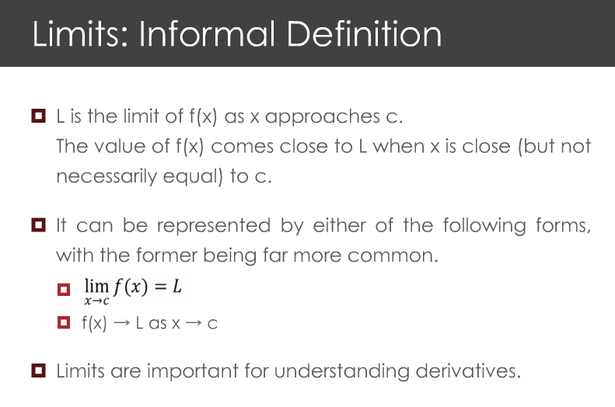
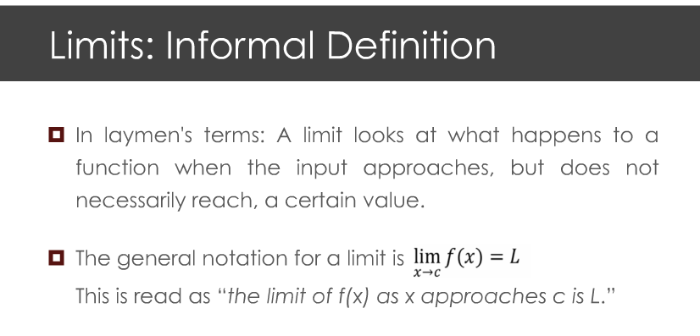

Slide 4
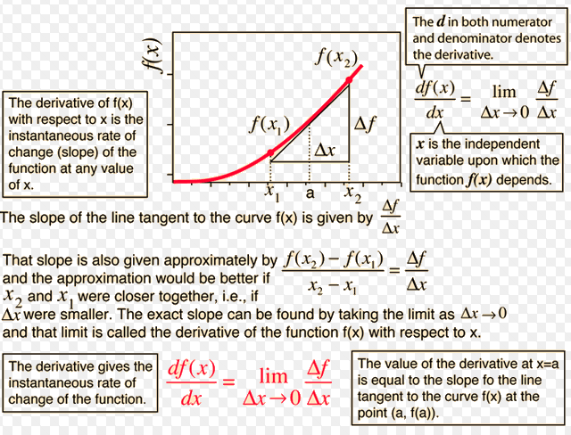
Derivative

Slide 5
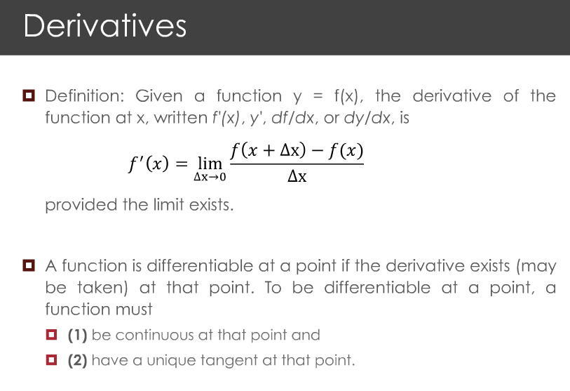
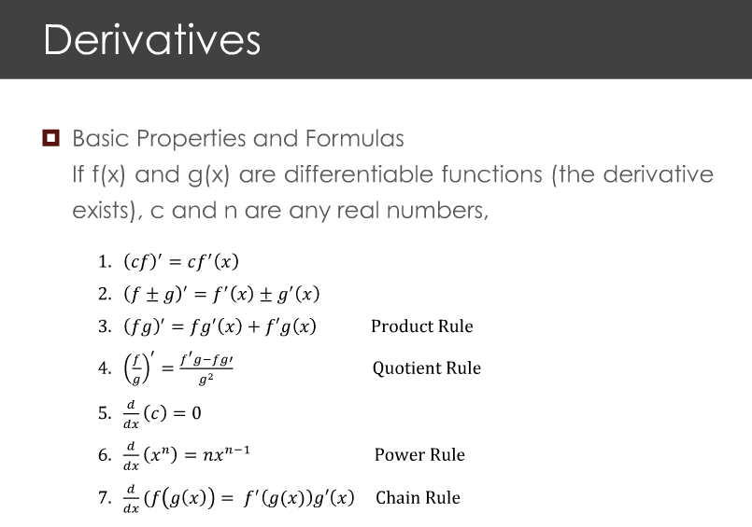

Slide 6
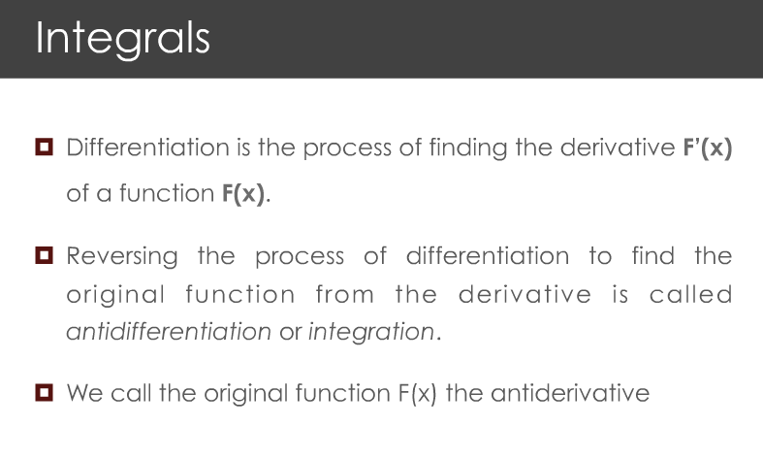
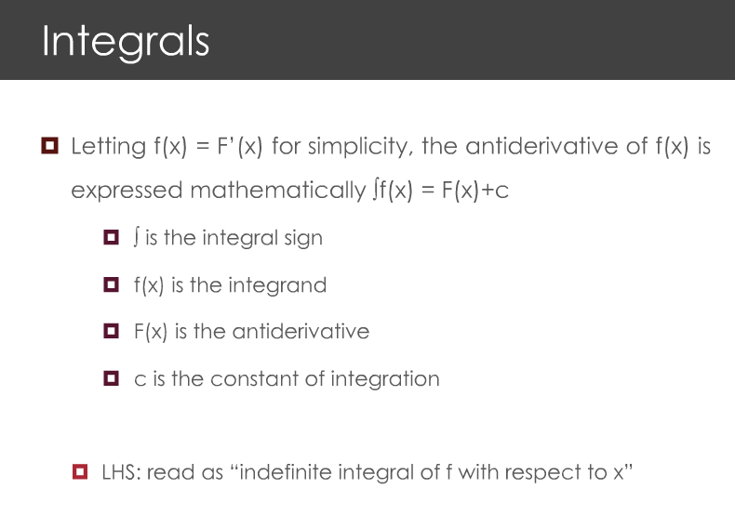

Slide 7
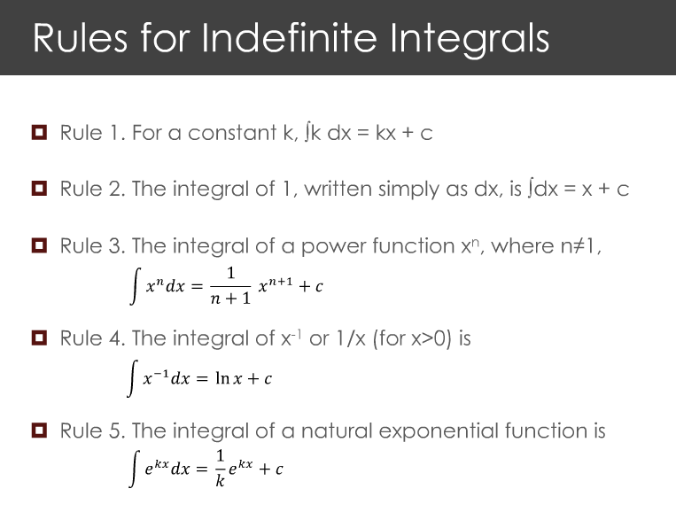
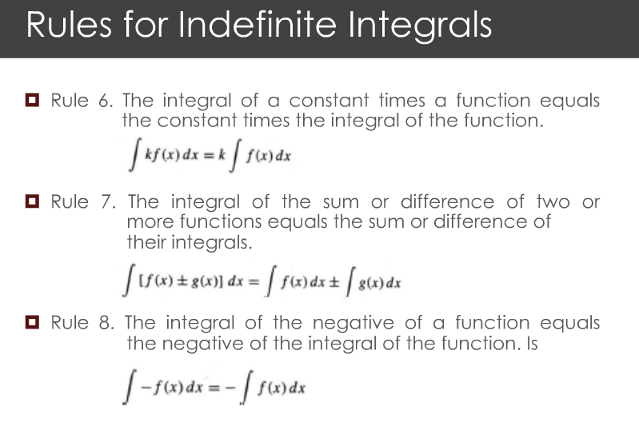

Slide 8
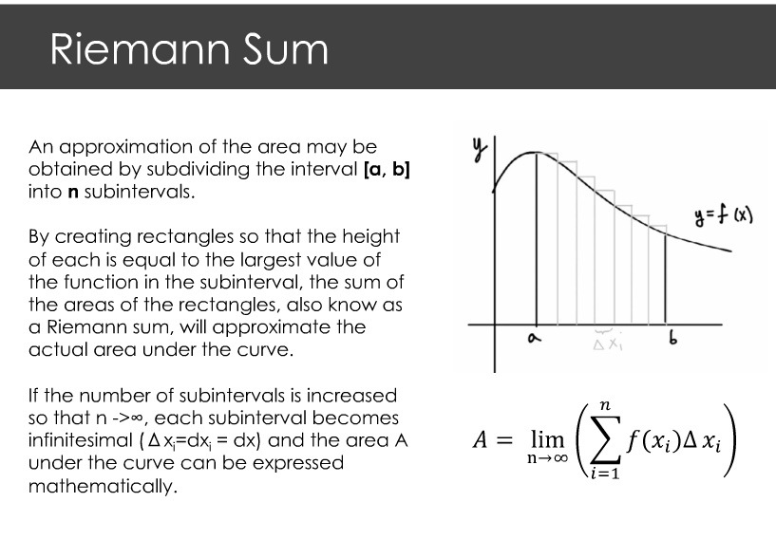
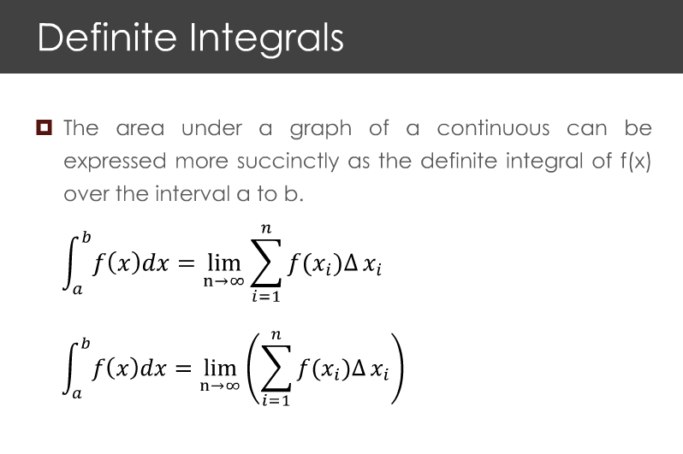

Slide 9
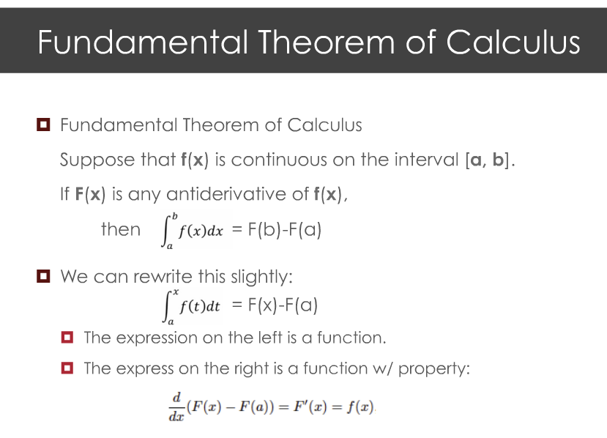

Slide 10
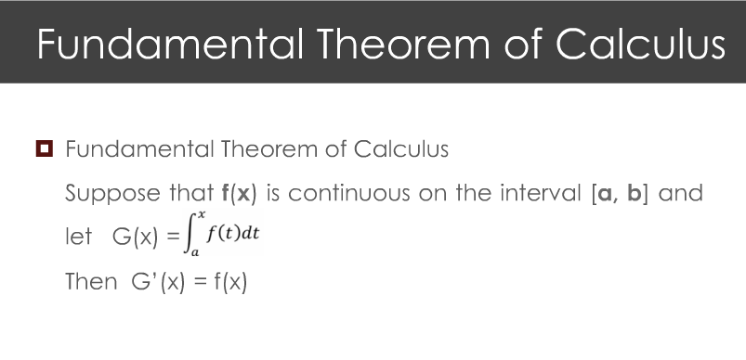

Slide 11
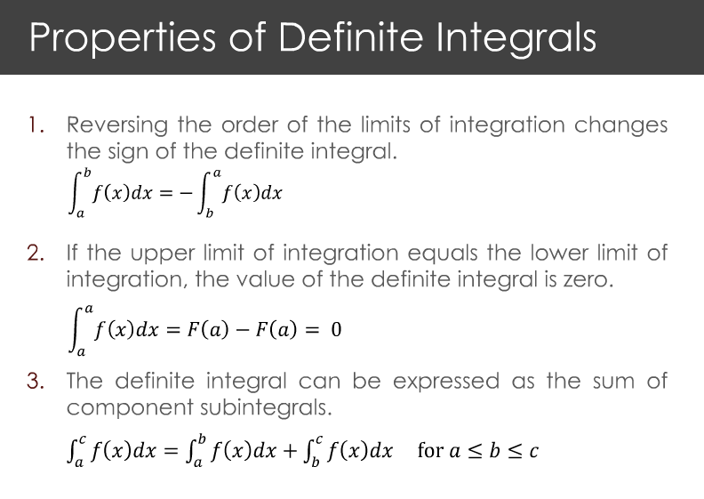
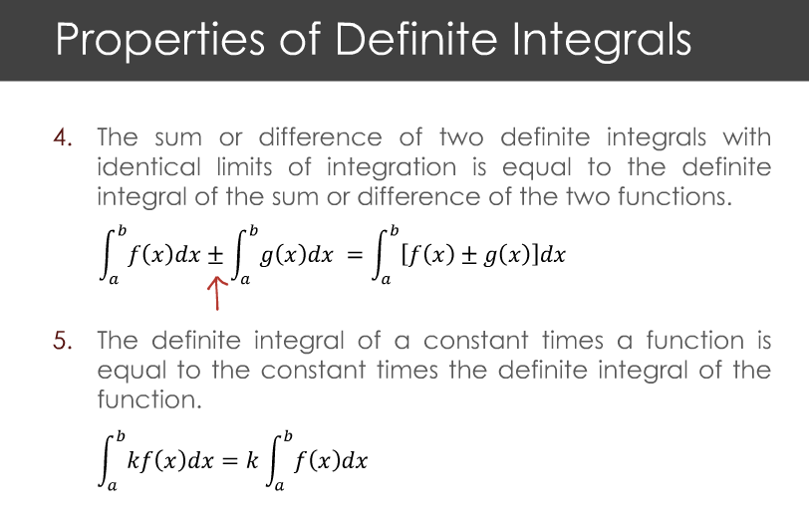

Slide 12
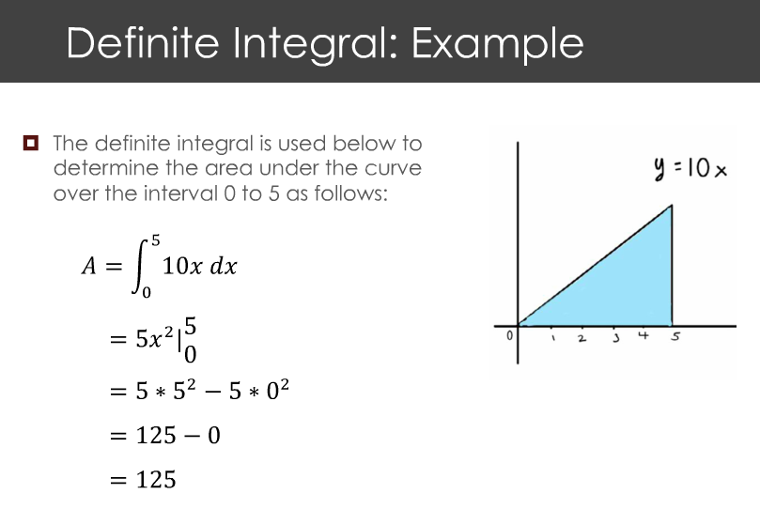

Slide 13
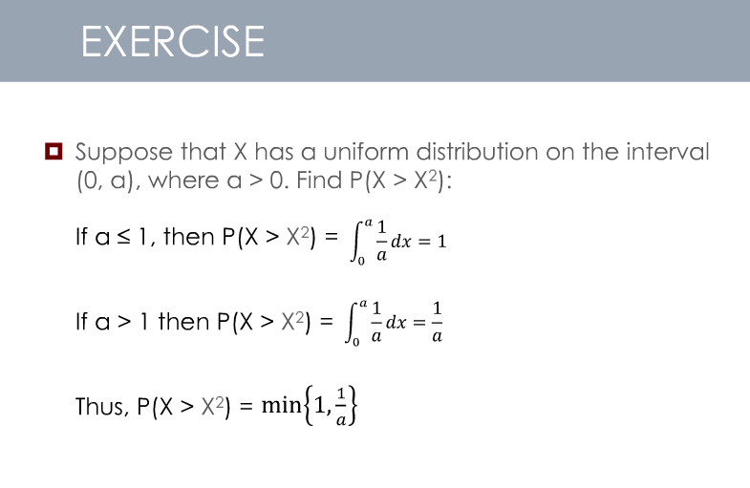

Slide 14
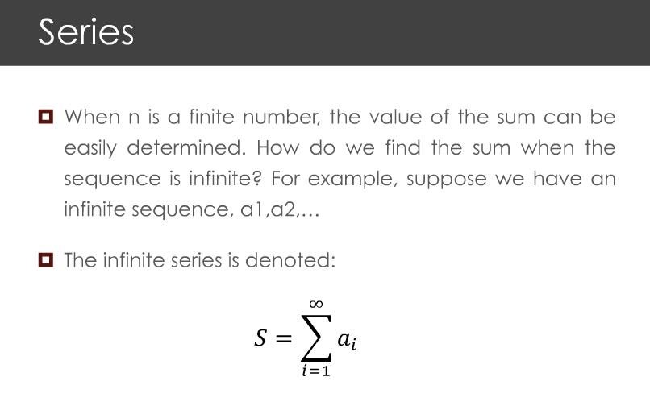

Slide 15
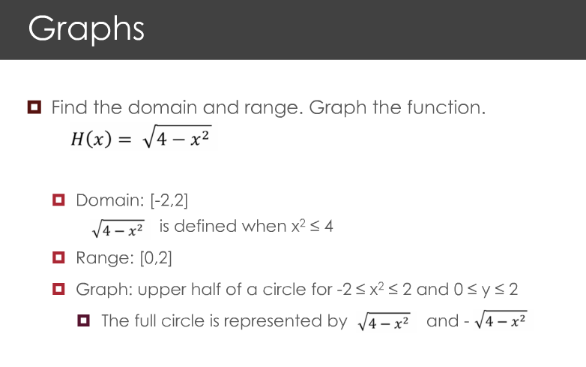

Slide 16
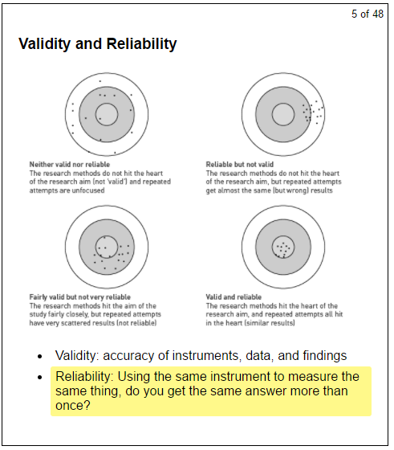
Week3 - Validity and Reliability
Validity – getting accurate answer
Reliability – getting the same answer
Notes:
I learned validity and reliability. Validity is accuracy of data. Reliability is consistency of getting the same answer more than once.

Slide 17
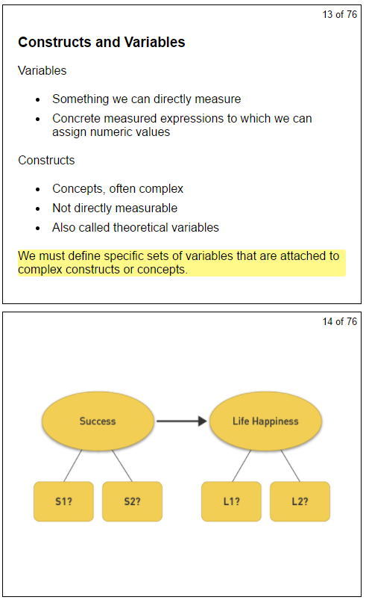
Week3 - Constructs and variables
In the real world, we are interested in something important but not directly measurable. For example happiness. We call these things “a construct”
We use “variables” that are measurable to represent constructs so that we can understand “a construct” better. Maybe we use “income”, “number of friends” as variables to measure “happinesss”
Notes:
I learned constructs in the async for this week. Constructs are concepts and something we are interested in but not directly measureable. We use variables that are measurable to represent constructs
What measurable variables can we use to get at a particular concept.
Operational definitions: how to measure a conceptual variable is really important.

Slide 18
Week3 - Time series data, cross-sectional data, pooled cross section, panel (longitudinal) data
Cross-sectional data: a sample of individuals at a given point in time
Time series data: looks at one individual at many times
Pooled cross sections: two or more cross sections from the same population, taken at different times
Panel data: multiple individuals, taken at multiple points of time

Slide 19
How to Operationalize a Complex Construct
How to tell customers are happy about using new products
Success of war <= body counts

Slide 20
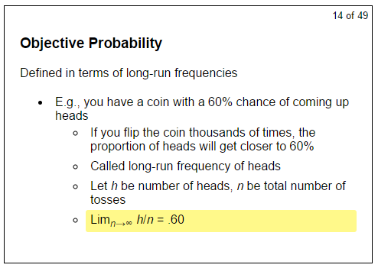
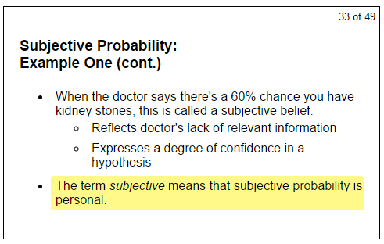
Week3 - Objective probability vs. Subjective probability

Slide 21
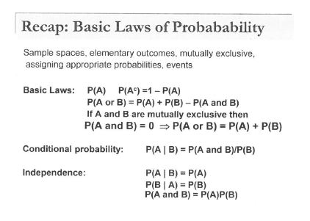

Slide 22
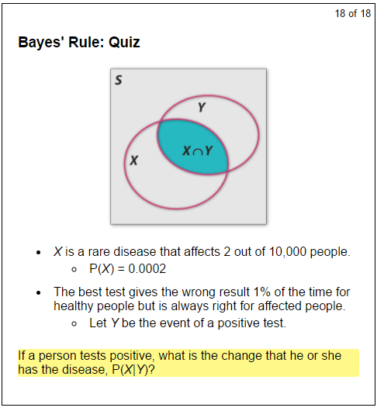
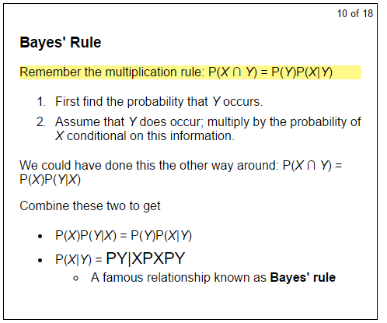
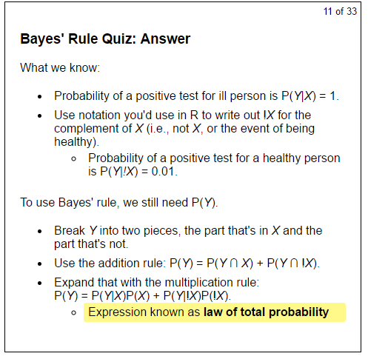
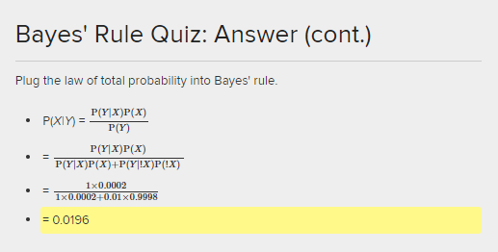
Week3 – Bayes Rule - Diagnosis
Easier to remember
P(X|Y) = P(X, Y) / P(Y)
P(Y|X) = P(X, Y) / P(X)

Slide 23
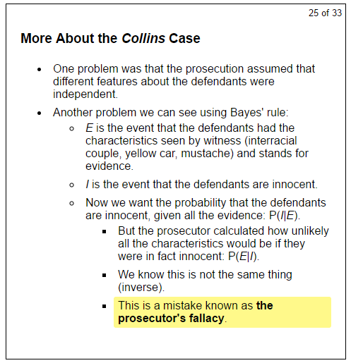
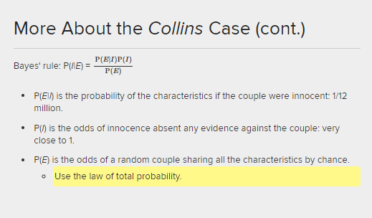
Week3 – Bayes Rule – Collins Case

Slide 24
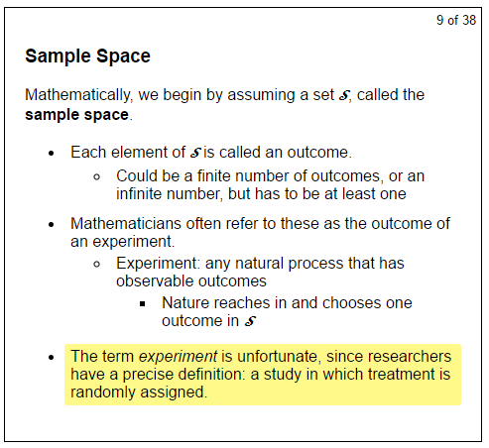
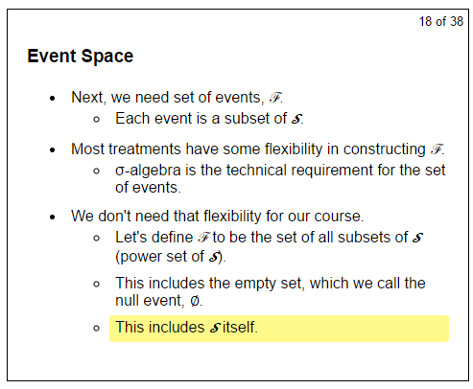
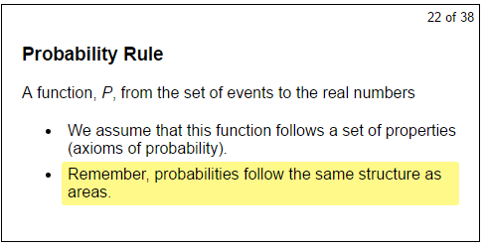
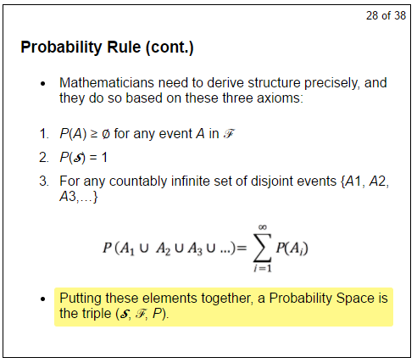
Week3 - Probability space
F

Slide 25
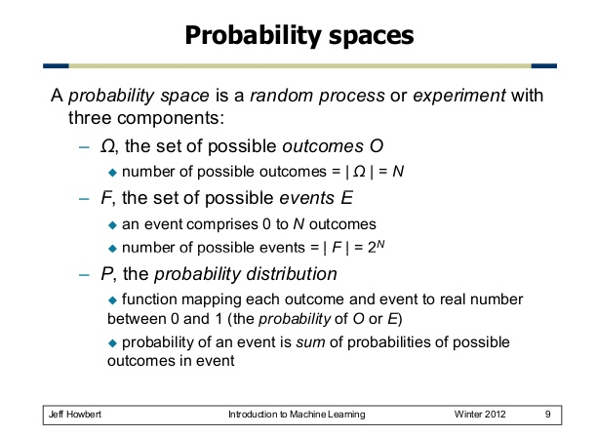
Week3 - Probability space2

Slide 26
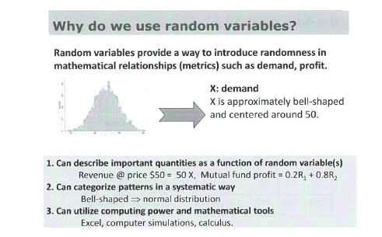
Week4 – why random variable?
Random variables provide a way to introduce randomness in mathematical relationships such as demand, profit

Slide 27
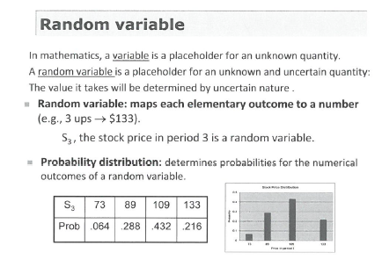
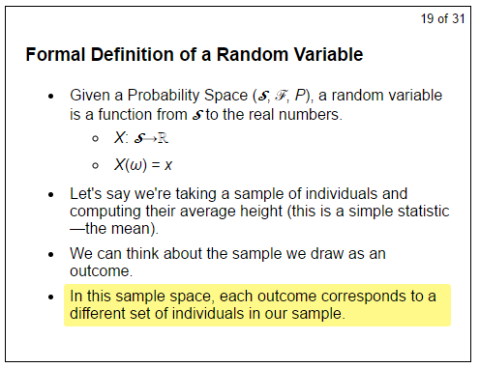
Week4 – random variable
(S,F, P)
Function X maps Sample to Real number
Function X taking event omega and mapping to value x
Outcome
Probability

Slide 28
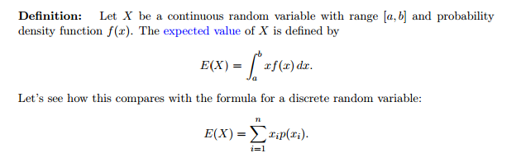
Week4 – Random Variable
Continuous Random Variable –
f - Probability density function,
F – Cumulative distribution function
E – Expectation (integral - area)
Discrete Random Variable – Coin (Bernulli distribution)
f - Probability mass function
F – Cumulative distribution Function
E – Expectation (sigma - sum)

Slide 29
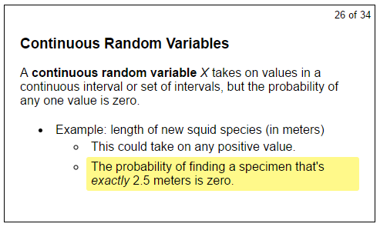
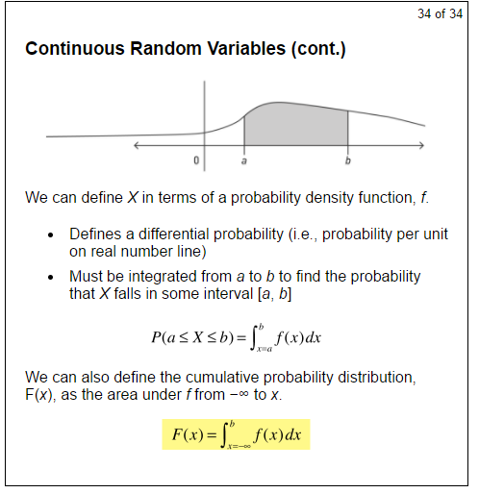
Continuous random variables

Slide 30
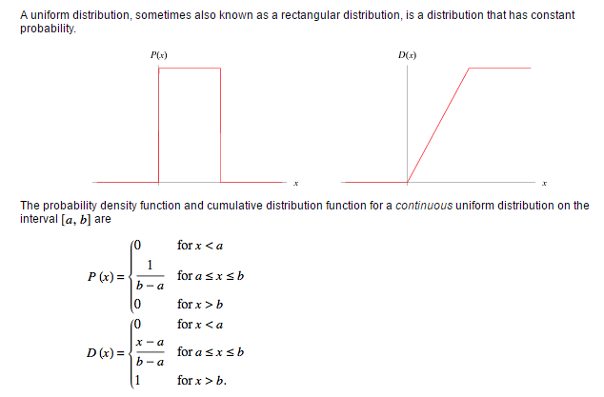
Continuous random variables – Uniform distribution
http://mathworld.wolfram.com/UniformDistribution.html

Slide 31
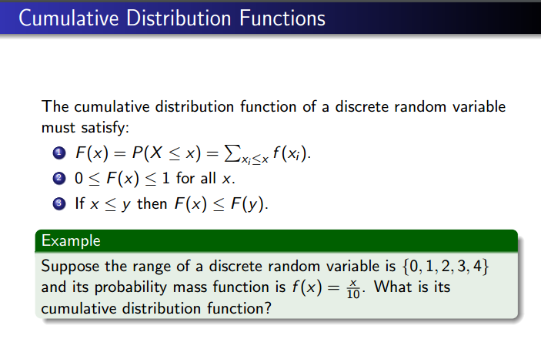
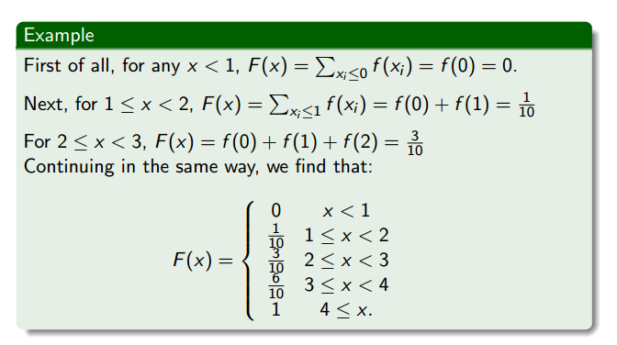
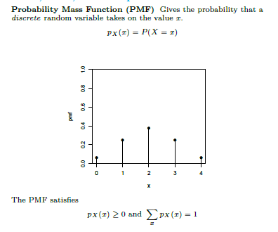
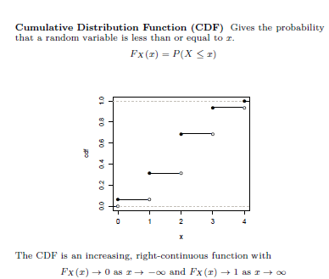
Discrete random variables

Slide 32
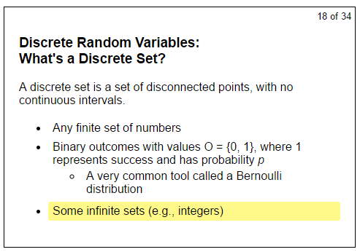
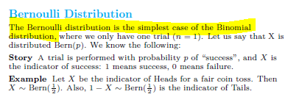
Discrete random variables - A Bernoulli distribution

Slide 33
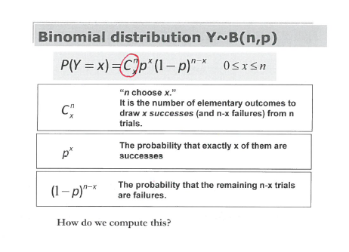
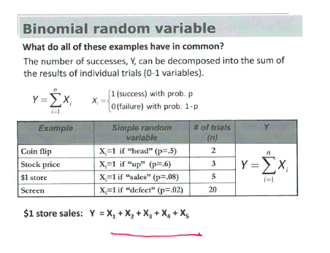
Discrete random variables - Binomial distribution

Slide 34


Week4 - Linear Functions of Random Variables

Slide 35



Week4- Expected Value

Slide 36


Week5- Joint Distribution

Slide 37



Week5 – Conditional Distribution

Slide 38



Week5 – Marginal Distribution

Slide 39


Week5 - Independence
Use confiditional probabability we did before

Slide 40

Week5 - Expectation

Slide 41

Week5 - Covariance

Slide 42

Week5 – Variance of Sums

Slide 43


Slide 44

Week5 – Law of Iterated Expectations

Slide 45


Week5- Covariance Matrix

Slide 46



Slide 47

Week5 - Sampling

Slide 48
Week5 – Standard error: the predictable amount or estimated expected value

Slide 49
Key sampling terms
Units of analysis (people, …)
Population, Selected sample, Actual Sample
Sampling designs (Quota, Random, Snowball, Stratified, Convenience)
Problems:
Obtain a representative sample
Outliers – real data but not helpful to understand overall distribution

Slide 50



Slide 51


Slide 52



